Slide 2
Data Modeling Overview

Slide 3
Data Modeling :
Pictorial Representation of Data and
relationships that exist between different data
Pictorial Representation of Data
Increase understanding of Data
Helps build consensus
Blueprint for Database Design

Slide 4
Different Types of Data Modeling Techniques
Conceptual, Enterprise Model
OLTP (Online Transaction Processing)
Dimensional

Slide 5
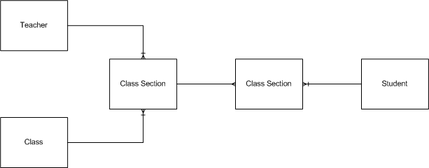
Conceptual Model
Different Definitions
Usually High level Model
Boxes with relationship lines
Few attributes

Slide 6
OLTP
Online Transaction Processing
More detailed Model
Should follow normalization rules
Rules that are applied to data
Organizes data into table and relationships
Identification of Primary and Foreign Keys

Slide 7
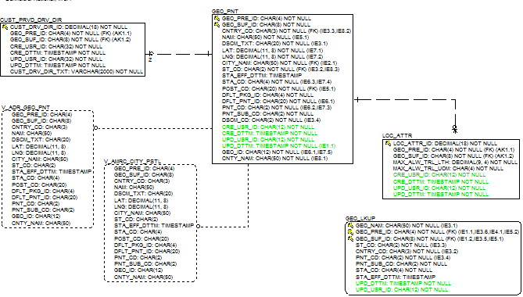
OLTP Example

Slide 8
Dimensional
For analytic Processing
More detailed Model
Data Organized into Facts and Dimensions
Star Schema’s
Data is Demoralized not Normalized

Slide 9
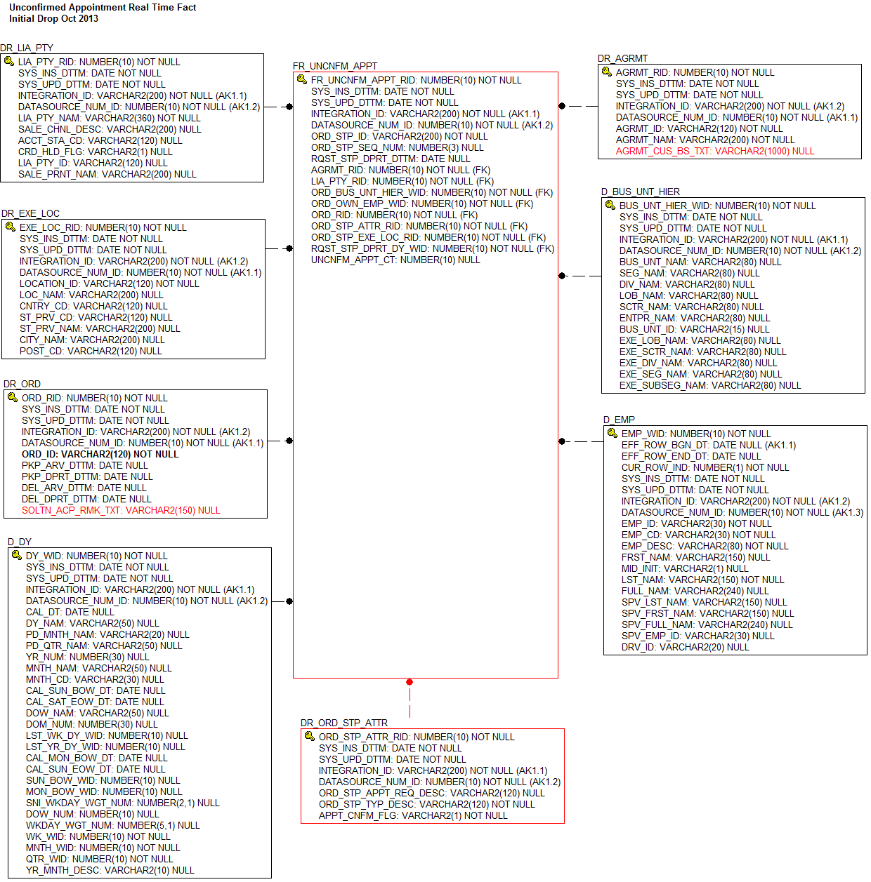
Dimensional Example

Slide 10
Erwin Logical vs. Physical Model
Logical | Physical | Description
Entity | Table | Collection of data The “Nouns” of the organizations
Attribute | Column | A element of data
Primary Key, Foreign Key | Primary Index | Defines Uniqueness or Dependencies
Relationships | Constraints | Show how tables and data are related

Slide 11
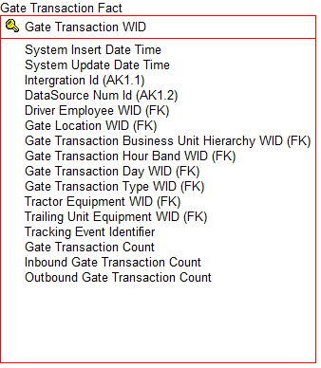
The Fact Table
Primary Key
Alternate Key
Foreign Keys
Degenerative Attributes
Measures

Slide 12
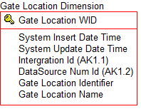
The Dimension Table
Primary Key
Alternate Key
Descriptive Attributes
AKA Dims

Slide 13
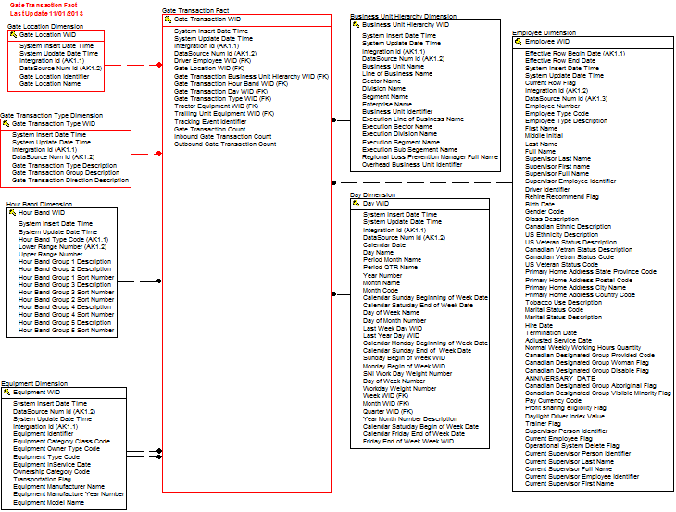
Together they form the Star

Slide 14
What is the Grain?
Single most Important question
Refers to the level of Data
Usually when talking about Facts
Also Dims
Multi Grain

Slide 15
Different Grains Means Different Types of Facts . . .
Transactional Fact
Captures Operational Events or Transactions
Usually has a Transaction Type Dim
Transaction Date is main or only date
Examples of . . .
AR Transaction Detail
AP Transaction Detail
HR Employee Head Count Event
Gate Transactions

Slide 16
Types of Fact Continued . . .
Current View Fact
Contains current picture of an operational object
Usually have operational object dim
Also may see Status Dims
RTA
Examples
Order Current
Shipment
Vacancy Accumulation

Slide 17
More Fact Table Types
Snapshot Fact
A picture in time
Time frame of Day, Week, Month
These time frames are trended over time
Examples
Driver Annualized Pay
HR Head Count
DNI

Slide 18
Summary Facts
Detail Fact data summarized
Often less dims than detail fact
Have same number of measures
Often done to support Cross Subject area analysis
PK may look odd

Slide 19
Remind me to talk about Fact less Facts . . . .
Derived Facts
Built from lower Level Fact Tables
Significant logic need from detail facts
New measures are derived
Not very common
Examples
DSO
DPO
Driver Annualized Pay

Slide 20
Bring on the Dimensions
Type 1
Type 2
Type 3
JUNK
Hierarchical

Slide 21
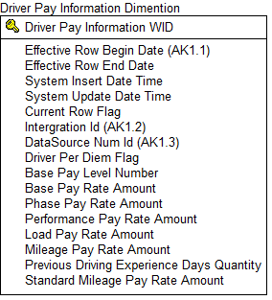
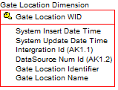
Type 1
Type 2
Current View
Don’t keep track of changes
You care when data changes - version
Additional Dates on Dim

Slide 22
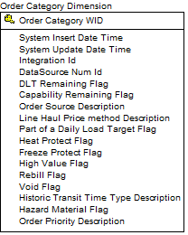
Type 3
Junk
Mixed
Some attributes updated
Some attributes are versioned
THE EMPLOYEE DIM
Contains the leftovers
Usually unrelated
Used combinations
A bit over used . . .

Slide 23
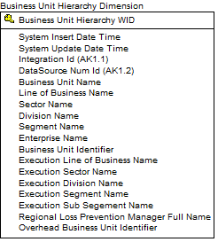
Hierarchal
Multigrain too
Denormalize data
Lowest level Child with parent attributes associated
Can contain multiple levels of data too
Supplier DIM

Slide 24
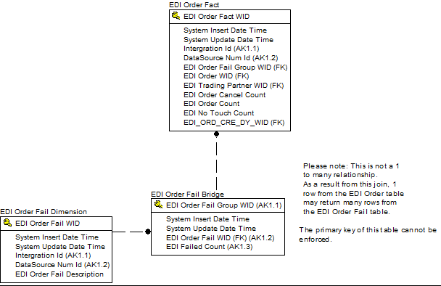
Advanced Topics . . .
Bridge
Resolves Many to Many
Not Common - blows out measures

Slide 25

More Advanced Topics
Identity Tables
Contains Cross reference for Dims
Associates Fact data to MDM Data

Slide 26
The End . . .

